Slide 1
DTA Assignment
Heart Disease Prediction

Slide 2
Problem Statement - World Health Organization has estimated 12 million deaths occur worldwide, every year due to Heart diseases
The goal of gathering this data
Scientists from around the world can communicate with each other thanks to the collecting of this information.
In order for the WHO to monitor cardiovascular illnesses.
For scientists to be able to have access to one document that shows statistics on the heart disease risk factors.

Slide 3
Problem Statement - continues
What problem/s is this dataset intended to solve
This dataset aims to eliminate disarray
Give precise details on the most important heart disease risk factors

Slide 4
Problem Statement - Continues
Why do I need to use this dataset, and what issue am I trying to resolve?
The goal of this study is to identify the most important heart disease risk variables and to use logistic regression to estimate the overall risk.

Slide 5
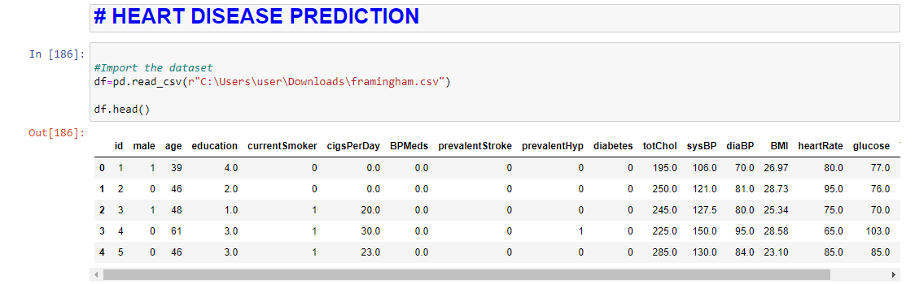
Import data

Slide 7
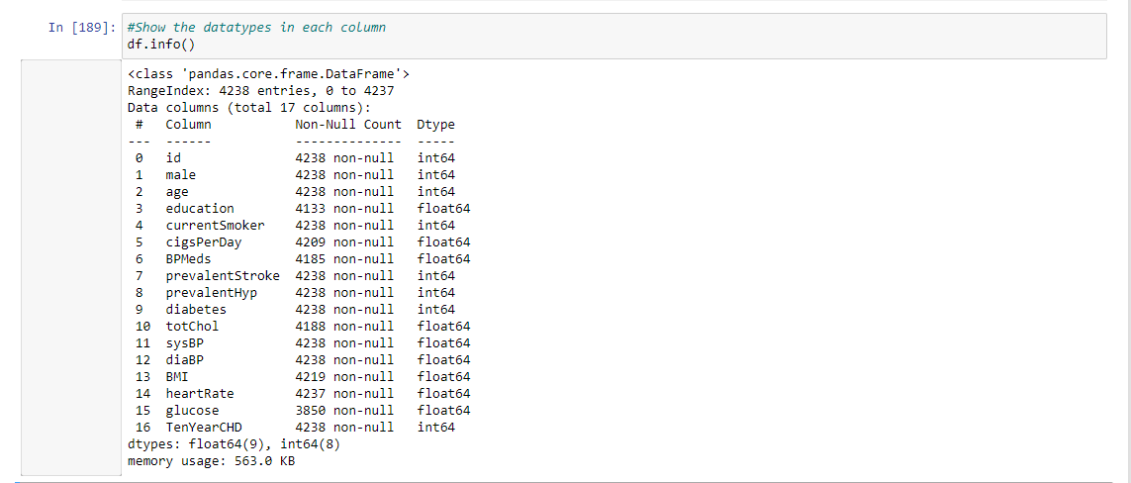
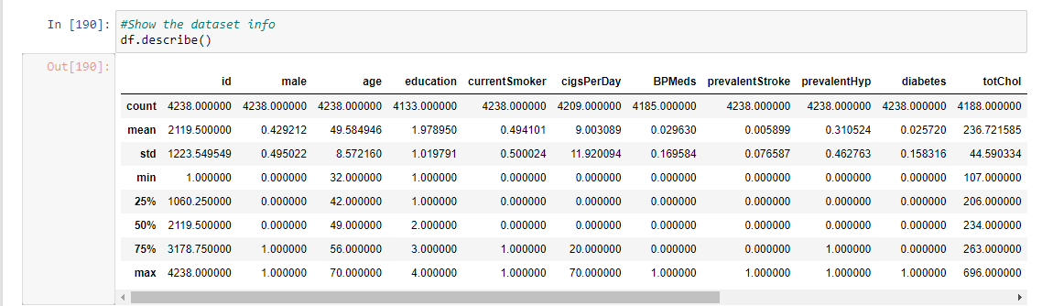
Data understanding – Describing

Slide 8
Data Cleaning
List of Columns
sex: male or female
age: age of the patient
currentSmoker: whether or not the patient is a current smoker
cigsPerDay: the number of cigarettes that the person smoked on average in one day
BPMeds: whether or not the patient was on blood pressure medication

Slide 9
Data Cleaning - Continues
prevalentStroke: whether or not the patient had previously had a stroke
prevalentHyp: whether or not the patient was hypertensive
diabetes: whether or not the patient had diabetes
totChol: total cholesterol level
sysBP: systolic blood pressure

Slide 10
Data Cleaning - continues
diaBP: diastolic blood pressure
BMI: Body Mass Index
heartRate: heart rate
glucose: glucose level
TARGET COLUMN:
10 year risk of coronary heart disease CHD

Slide 11
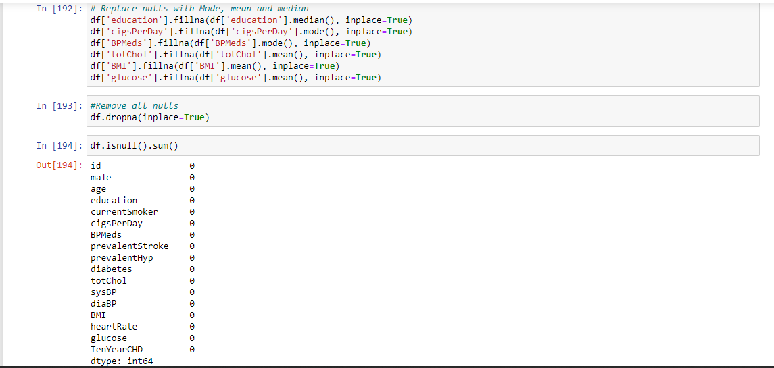
Data Cleaning – handling missing data
Nulls in the column education were filled with the median value of education
Nulls in the cigsPerDay column were filled with the mode value of cigsPerDay column
Nulls in the BPMeds column were filled with the mode value of BPMeds column
Nulls in totChol column were filled with the mean value of totChols column
Nulls in BMI column were filled with the mean value of BMI column
Nulls in Glucose were filled with the mean value of the Glucose column
Drop all Nulls which were not filled with the median, mean and mode

Slide 12
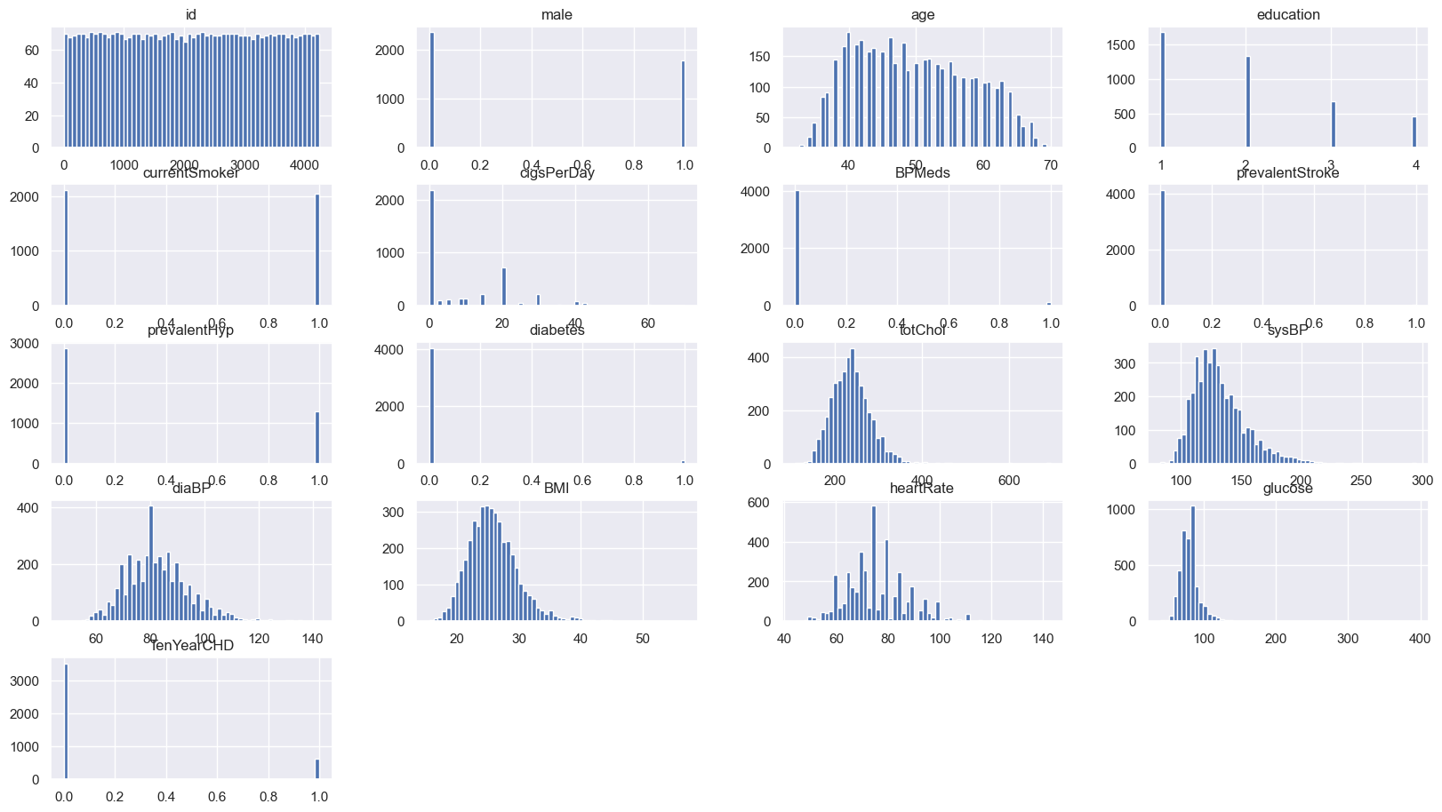
Exploratory data analysis
The data is fairly distributed with in all the columns. But some columns such as glucose, totChol, diaBP, sysBP are showing to have some outliers.

Slide 13
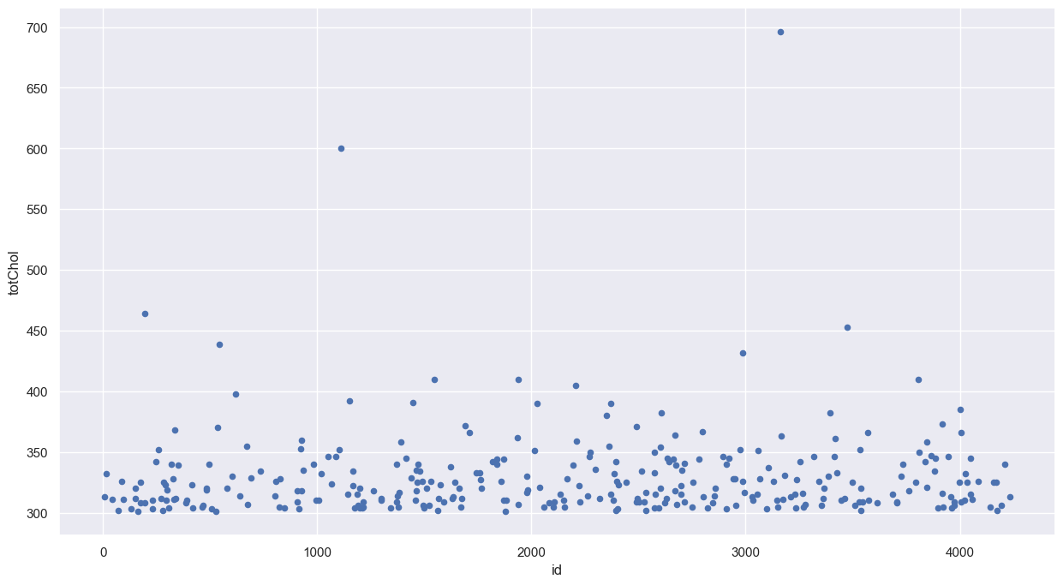
Data exploratory
Scatter plot for totChol showing that the are a few outliers

Slide 14
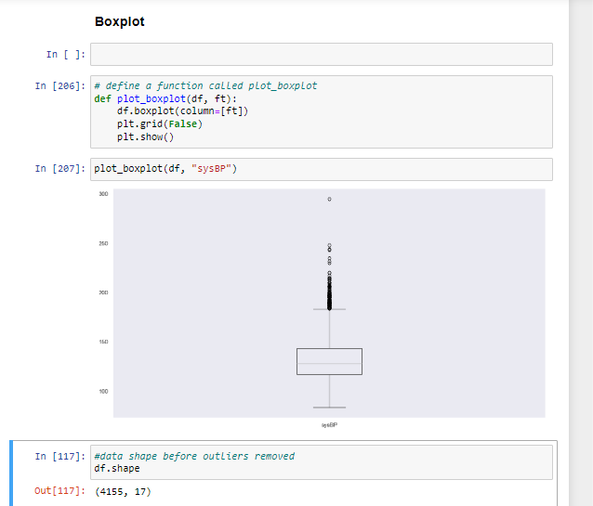
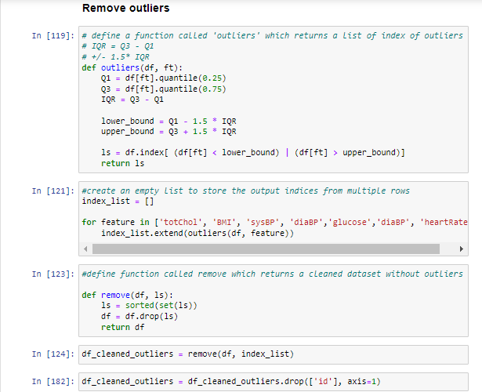
Exploratory data analysis - outliers

Slide 15
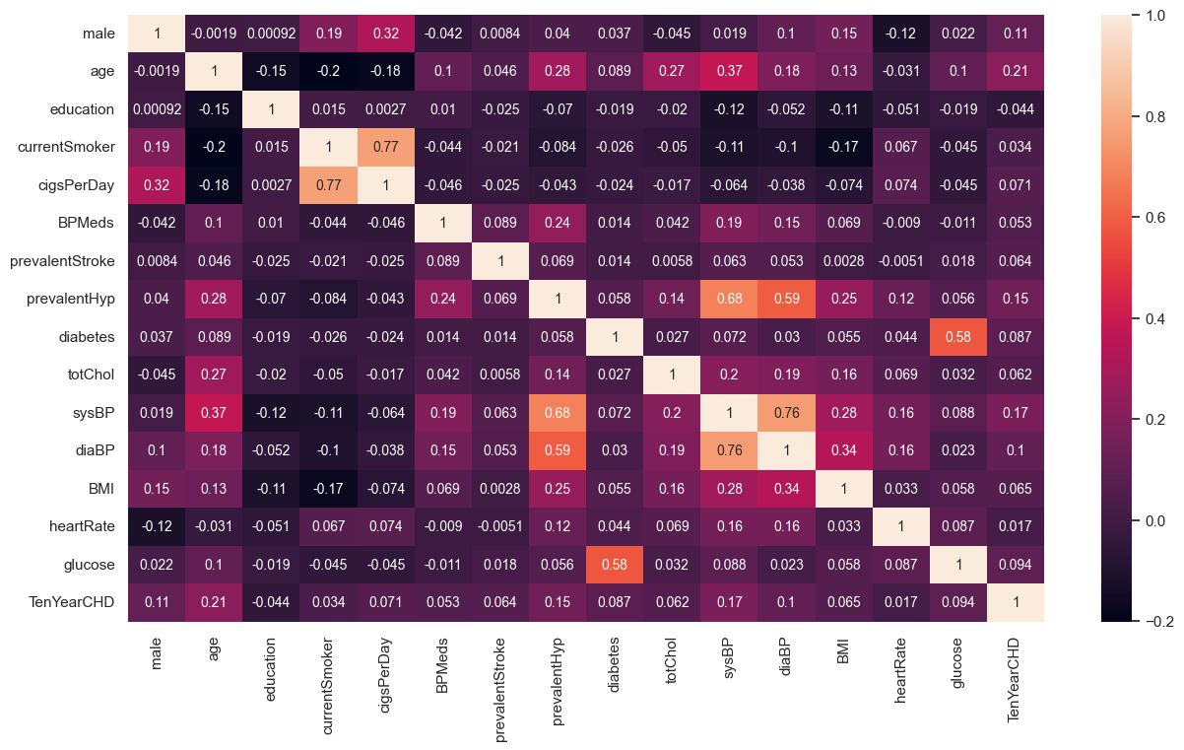
Correlation matrix heatmap

Slide 16
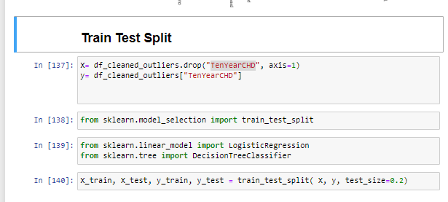
Data Modelling
Save the column Target column TenYearCHD in the variable y
Save the Columns besides TenYearCHD in the variable X
Split the data, 20% for testing and 80% for training.

Slide 17
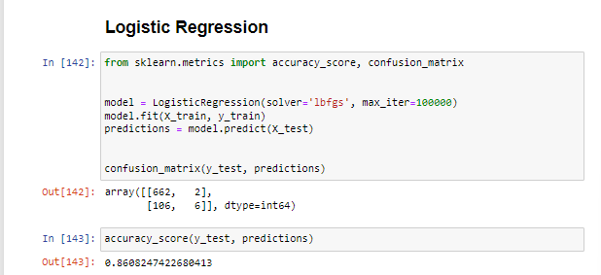
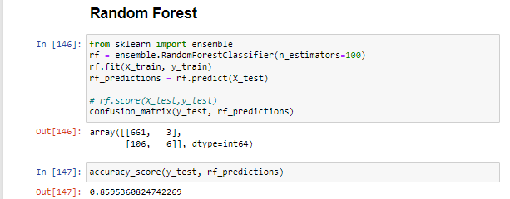
Machine learning models

